Slide 1

Success with Robotics & AI
Workshop
David.Wright@Kofax.com
Partner Development Manager
Notes:
Winning the Customer in the Cognitive/AI/RPA World.
Session Goals :Understand and articulate the value of focusing on human performance rather than machine performance in RPA & CDA opportunities.
Various Case Studies to make the problem very clear.

Slide 2
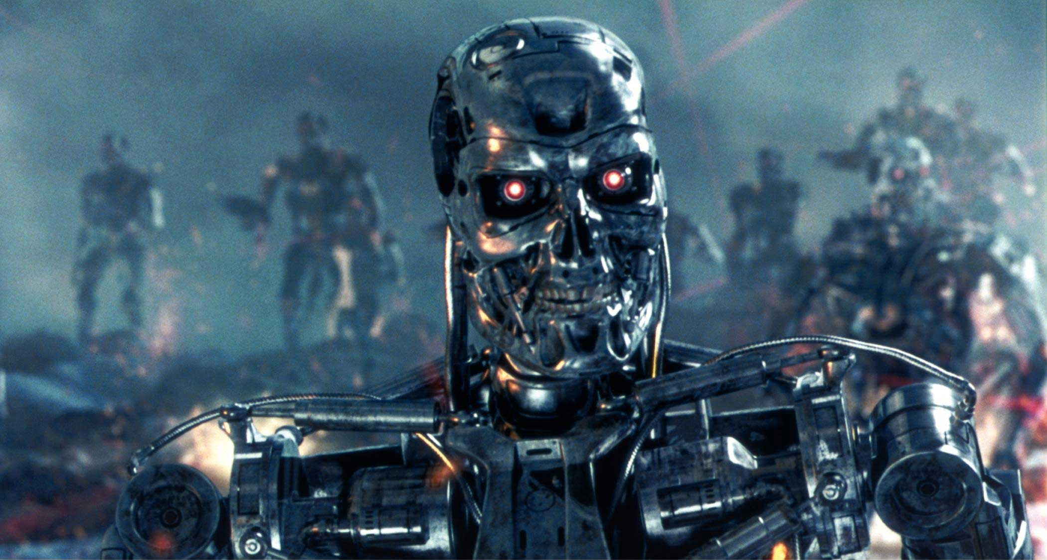
Notes:
Is your understanding of RPA stuck in the 1980’s with robots coming to take your job?
The Terminator movies of 1984 and 1991 personified the risk of AI as terminator robots intent on killing humans, so the humans rebelled. The “AI Skynet” they were talking about then was actually just a database: the SQL database was entering into the business world – data was being digitized. No-one fears a database today more than 30 years later. The AI fears of today will not concern our children.

Slide 3


Notes:
RPA is really about enhancing not replacing human performance. Do not try to remove people. You want people to do smart, creative tasks in a process. Only automate what a human doesn’t want to do.
This photo is part of a series about robots and humans interacting – but this photo is special, because the robot is working for the human in a passive way. The human is in full control – this is Kofax’ model of human-robot cooperation.
This image is common on the internet.
It can be found here https://www.gettyimages.at/detail/foto/robot-and-businesswoman-using-computer-stock-fotografie/529301356
The earliest reference I find of it is http://carlibux.blogspot.com/2010/12/human-vs-robot.html. There is a question from me 6 Sep, 2013 asking for the owner, with no reply.

Slide 4

Notes:
https://www.shutterstock.com/image-photo/concentrated-confident-mature-man-working-android-662279113
#

Slide 5
What’s happening with Artificial Intelligence?

Slide 6
Buzzwords
Intelligent
Smart
Clever
Cognitive

Slide 7
Not Buzzwords
Machine Learning
Deep Learning
Learn-by-example
Supervised machine learning
Bayesian classifiers
Natural Language Processing

Slide 8

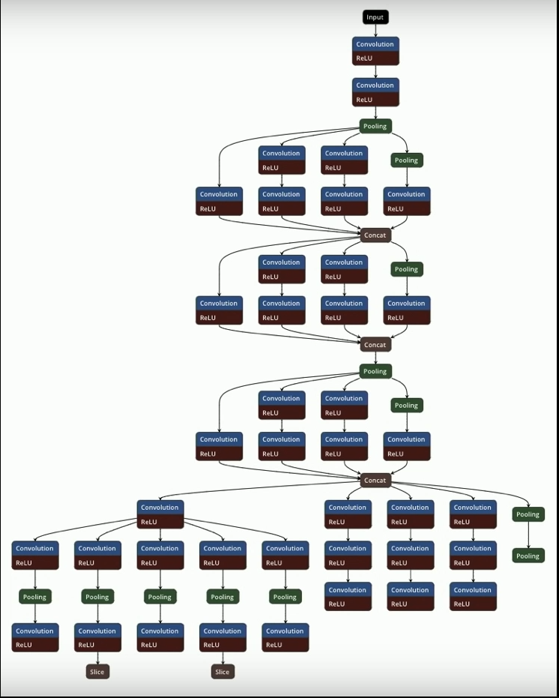
AI can be very complicated
Notes:
Tesla’s Self Driving Car AI is a network of Deep Learning Networks.
Good AIs need incredibly skilful AI Engineers.
Tesla Autonomy Day
Streamed live on Apr 23, 2019
https://youtu.be/Ucp0TTmvqOE?t=5110

Slide 9
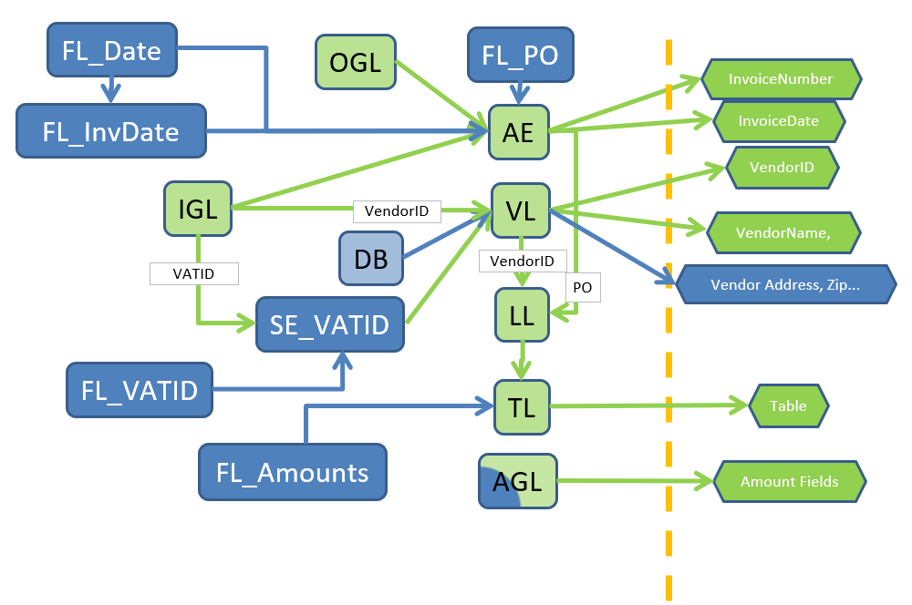
Invoice processing: AI + rules + rescoring + lookups + flow + learning
Trainable
Rules-based
Pattern-based classification
Fuzzy index lookup
5 Table detection algorithms
Text pattern recognition using SQL results
Rescoring algorithms

Slide 10
Problems that Kofax tackles with AI
Reasoning and Problem Solving
Natural Language Processing
Creativity
Knowledge Represen-tation
Motion
and Manipu-lation
Planning
Perception
Learning and Adaptation
Social Intelligence
Notes:
Perception:
Computer Vision
Pattern matching
Sensors, cameras, mics
Face recognition
What is in the image? (ImageNet competition)
NLP:
Speech
ICR/OCR
Translation
Intent, Sentiment, Entities
Chatbots
Learning and adaption:
Generalization, unknown situations
Classification
Machine Learning
Planning:
Go find the bananas in the other room
Intelligent Agents / Multi Agent Systems
Provisioning, Logistics

Slide 11

Document Classification*
Data Extraction*
Language Detection*
Table Header Detection*
Paragraph Separation
Predictive / Probabilistic
Document Separation*°
Image Cleanup
Document Clustering
RPA Process Analysis
Machine Learning
OCR | ICR
Mobile OCR
VRS page rotation
Neural Network
Artificial Intelligence at Kofax
Signature Verification
Facial Recognition
Handwriting Detection
Natural Language Processing
Context Extraction*
Sentiment Analysis
Named Entity Recognition
Syntax
Analysis
Document Summarization
= Roadmap item
Vision
Image Classification*
Line detection
RPA Dynamic Screen Interpretation
Document Edge Detection
= Supervised ML
= Unsupervised ML
*
= trainable
°
= Hidden Markov Model
= Kofax Transformation

Slide 12











Kofax-orchestrated AI.
Connecting to specialized algorithms, to create solutions out of services.
Providers listed are examples only

Slide 13
Natural Language Processing with Kofax

Slide 14
Natural Language Processing Engine
2
German, English, Spanish, French, Italian, Japanese, Korean, Dutch, Portuguese, Romanian, Chinese
Overview Streamline your data collection process and get closer to your employees and customers with less manual effort when you can automatically gather insights from text-based communications using NLP. Use NLP with your software robots to automatically read and interpret communications such as emails, legal documents, complaint letters, social media sites and more.
Business Benefits:
Increases efficiency and productivity by automatically understanding information and sentiment in text-based communications, reducing the need for manual review.
Lets organizations more efficiently monitor relevant social media trends with ease.
Helps companies get closer to employee and customer needs.
What’s New
Sentiment Analysis
Named Entity Extraction
What can NLP do?
NLP classifies the meaning and tone of any natural text, giving you more insights with less work. When attached to an RPA robot, NLP can make your robots more efficient, productive and responsive to business operations by answering four primary questions:
Who is talking?
What are they talking about?
What are they saying about those subjects?
How do they feel?
Notes:
With 10.7, Natural Language Processing (NLP) has been enhanced in the document transformation service (DTS) with two key features – Sentiment Analysis and Named Entity Extraction
This eliminates the manual effort required to understand text-based communications by deploying Kofax software robots. These robots can automatically read and interpret natural language-based communications such as emails, legal documents, complaint letters and more. This new sentiment analysis and named entity extraction helps detect the mood of text, such as positive or negative, and extract entities, such as company names, person names, and so on. Organizations can use this to process customer reviews to understand whether customers are satisfied with the service or not. And, it can be uses to find all mentions of a company in an article.

Slide 15
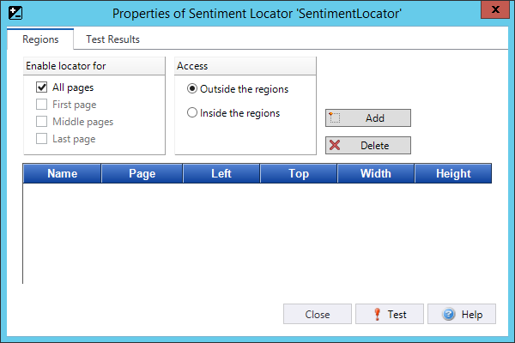
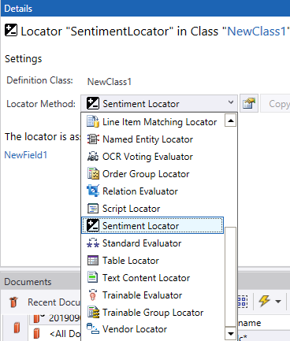
Natural Language Processing Engine – RPA 10.7
2
Sentiment Analysis
Sentiment Locator
Sentiment analysis is a technology that pulls phrases from natural text to systematically identify, extract, quantify, and study words to detect the emotional state of the author and categorize them. Kofax NLP ranks sentiments on a scale from -1 (very negative), to 1 (very positive).
Benefit: helps organization make better decisions based on a clearer understanding of the voice of the customer or employee.
Sentiment analysis returns a sentiment score for the text or region
-1 = very negative 0 = neutral 1 = very positive
Notes:
Benefits of Sentiment Analysis
Increase efficiency and productivity by automatically understanding information and sentiment in text-based communications: Kofax NLP empowers Kofax customers to quickly understand natural language text-based business information without the need for human intervention, turning the content of an email or legal document, for example, into usable digital information. NLP can reliably find names of parties to a contract, mortgage, loan or other agreement. It can automatically interpret a text-based instruction to open/close an account, add/cancel a policy, change a beneficiary, change address, etc. It can automatically recognize that a customer is reluctantly canceling their subscription, so a company representative can focus their account management effort on that customer specifically. The result is productive use of time in the workforce and greater efficiency in business processing.
Make better decisions through a better understanding of the Voice of the Customer: By transforming natural language-based customer feedback into structured data and useful insights at scale, Kofax customers make better decisions and recommendations that impact customer experience.
Improve employee engagement by understanding the Voice of the Employee: Kofax NLP enables Kofax customers to improve employee engagement and loyalty by gathering, analyzing and interpreting employee feedback. McKinsey & Co. finds that People Analytics, fueled by Natural Language Processing, can improve recruiting efficiency by 80%, raise productivity by 25%, and reduce attrition by 50%.
Efficiently monitor relevant Social Media trends: Kofax NLP equips Kofax customers to understand the stories and opinions of social media while removing the effort from social media monitoring. Useful nuggets and meaningful threads from social media comment are found automatically, providing new opportunity to understand what’s working and what’s not. For example, understand why people don't give an audio headset product 5 stars by uncovering positive comments about sound and comfort while uncovering negative comments about the cable and the plug. Or, detect trends in market by analyzing social media posts from influencers.

Slide 16



Sentiment Analysis
2
Guage sentiment of natural language, at the document, paragraph or perhaps clause level
Just wanted to thank you for your excellent service (0.273) in handling my insurance claim.(0.273) Your app was so easy to use(0.368), you were always there to help when I needed it(0), and you sent the claim payment promptly(0.227). I will recommend you to all my friends (0.303).
0.29
Positive
I have submitted all claim information as requested(0). Please tell me when I can expect to receive the reimbursement check. (0)
0.00
Neutral
I would like an insurance quote on my lovely new boat(0.3), can you contact me?(0) Not happy about my auto rates going up (-0.20), so anything you can do there would be great as well (0.3).
0.05
Mixed
Your claims department is useless (-0.245). It has been 1 month and I still have not received my insurance claim payment (0). Multiple calls into your company and no one knows what is going on (0). I am very unhappy with your service (-0.436) and plan to switch insurance companies (0) and tell all my friends on social media (0.33). –(0.81)
-0.14
Negative
Notes:
Use sentiment results to automatically escalate unhappy customers, or determine next steps in a workflow.

Slide 17
Sentiment Analysis
Sentiment analysis (also known as opinion mining or emotion AI) refers to the use of natural language processing, text analysis, computational linguistics, and biometrics to systematically identify, extract, quantify, and study affective states and subjective information. (Wikipedia)
Sentiment analysis provides hints about the emotional state of the author of a text or about his/her opinion on something (Markus Lust)
Sentiment Analysis can help
a business to understand the consumer’s opinion of their brand, product or service while monitoring conversations or social media posts.
to prioritize incoming emails or tickets in a Customer Support center
to detect trends in survey results
Sentiment Analysis is not exact. Humans are very good at expressing sentiment in very complex ways.
Sentiment on document level vs. entity level

Slide 18
Sentiment Analysis
Simple cases
Coronet has the best lines of all day cruisers.
Bertram has a deep V hull and runs easily through seas.
Pastel-colored 1980s day cruisers from Florida are ugly.
I dislike old cabin cruisers.
More challenging examples
I do not dislike cabin cruisers. (Negation handling)
Disliking watercraft is not really my thing. (Negation, inverted word order)
Sometimes I really hate RIBs. (Adverbial modifies the sentiment)
I'd really truly love going out in this weather! (Possibly sarcastic)
The movie is surprising with plenty of unsettling plot twists. (Negative term used in a positive sense in certain domains).
I love my mobile but would not recommend it to any of my colleagues. (Qualified positive sentiment, difficult to categorise)
Next week's gig will be right koide9! ("Quoi de neuf?" Fr.: "what's new?". Newly minted terms can be highly attitudinal but volatile in polarity and often out of known vocabulary.)

Slide 19
Sentiment Analysis
New Sentiment Locator
No configuration
Returns a sentiment score for the entire text or region
-1 = very negative
0 = neutral
1 = very positive

Slide 20
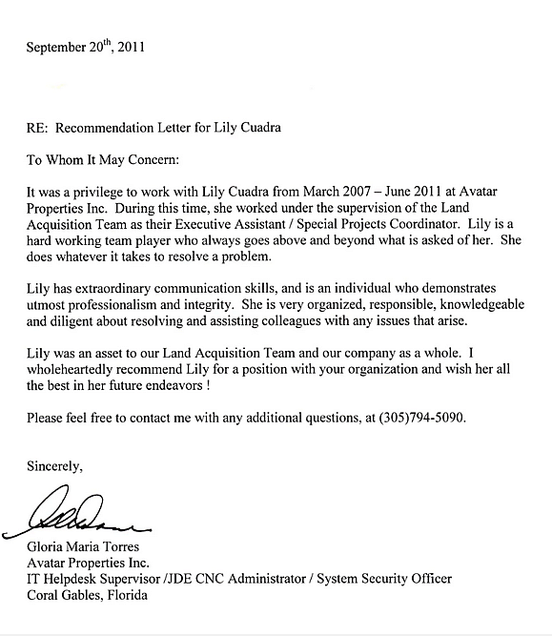
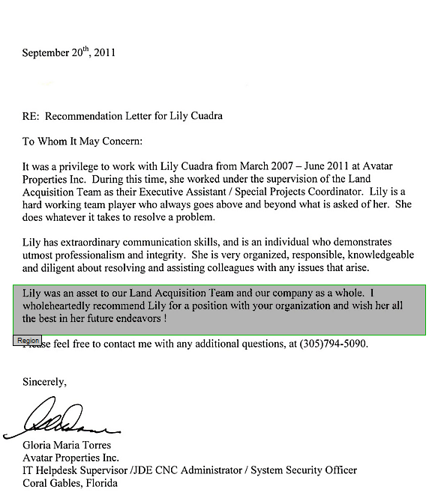
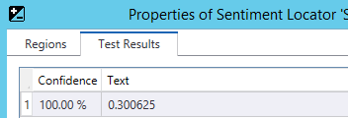
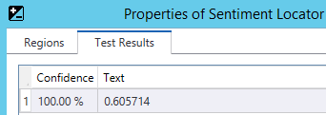
Sentiment Analysis
Entire document vs. a region

Slide 21
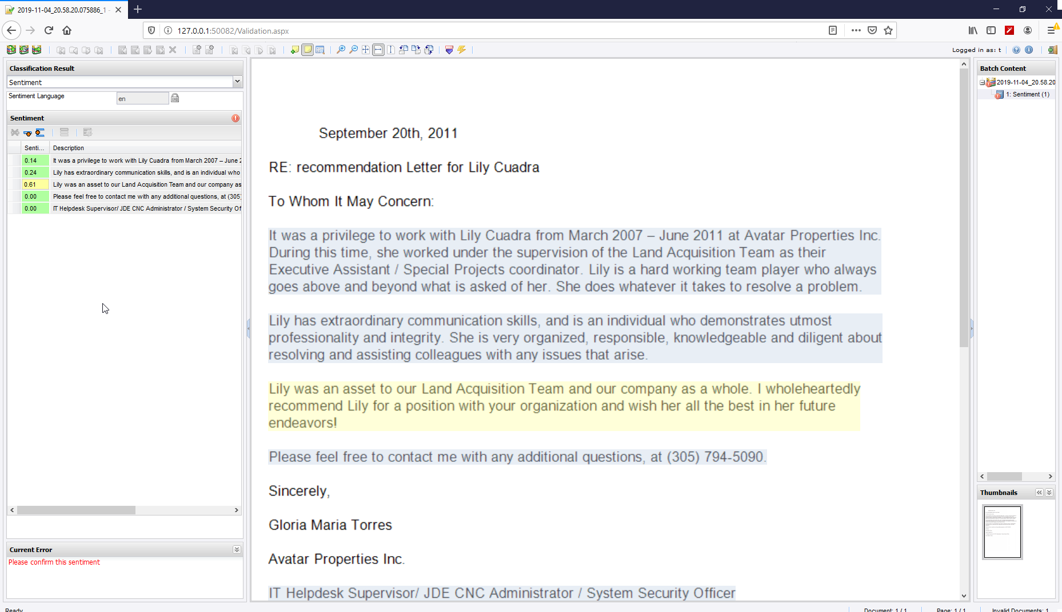
Download it from https://github.com/KofaxRPA/Sentiment/
Find sentiment of document, page, paragraph, sentence or custom dynamic elements.
Create image from text files for interactive validation.
Formatting and validation rules for sentiment.
Pass parameters from robot (e.g. language of text).
On-the-fly language selection.
Compatible also with KTM, KTA & RTTI

Slide 22
Sentiment Analysis – 5231 paragraphs from Wikipedia
There is a slight tendency to positive sentiment
20.2% of paragraphs have Sentiment=0
Sentiment | % of paragraphs
0.0 | 20%
0.0→0.1 | 23% (43%)
0.1→0.2 | 20% (63%)
0.2→0.3 | 28% (91%)
0.3→0.4 | 6% (97%)
0.4→0.5 | 1% (98%)
3.8% of paragraphs have Sentiment=0.25
0.1% of paragraphs have Sentiment=0.52
1 paragraph has Sentiment = -0.75138
1 paragraph has Sentiment = 0.8694

Slide 23
Lowest Sentiment – Wikipedia 5321 Paragraphs
Sentiment | Text
-0.75138 | The fact that handwritten allographs differ so widely from person to person, and even from day to day with the same person, means that handwriting recognition software is enormously complicated.
-0.65738 | Structurally, anthracite shows some alteration by the development of secondary divisional planes and fissures so that the original stratification lines are not always easily seen. The thermal conductivity is also higher; a lump of anthracite feels perceptibly colder when held in the warm hand than a similar lump of bituminous coal at the same temperature. The chemical composition of some typical anthracites is given in the article coal.
-0.59218 | However, most languages have words that are more complicated than a sequence of CV syllables, even ignoring tone.
-0.5724 | Public-domain software is a type of FOSS, which is royalty-free and - openly or reservedly- can be run, distributed, modified, reversed, republished or created in derivative works without any copyright attribution and therefore revocation. It can even be sold, but without transferring the public domain property to other single subjects. Public-domain SW can be released under an (un)licens
-0.5625 | Under the terms of the Treaty of Versailles, Germany was not allowed to build airships of greater capacity than a million cubic feet. Two small passenger airships, LZ 120 Bodensee and its sister ship LZ 121 Nordstern, were built immediately after the war but were confiscated following the sabotage of the wartime Zeppelins that were to have been handed over as war reparations: Bodensee was given to Italy and Nordstern to France. On May 12, 1926, the Italian semi-rigid airship Norge was the first aircraft to fly over the North Pole.
-0.549 | Native speakers of a given language perceive one phoneme in the language as a single distinctive sound and are "both unaware of and even shocked by" the allophone variations that are used to pronounce single phonemes.
-0.549 | In 1450, however, Sir Edward Nevill, widower of the 3rd Baroness, was summoned to Parliament as Lord Bergavenny. It has been assumed that this summons was intended to be in right of his wife, but as she was already dead and the Barony was already vested in her son by Nevill, by modern doctrine this served to create a new Barony by writ. This second creation merged with the first creation in 1476, when the 1st Baron died and his son, the aforementioned 4th Baron of the first creation, also became 2nd Baron of the second creation.
-0.53139 | The golden ratio seems to be reflected in many Egyptian constructions, including the pyramids, but its use may have been an unintended consequence of the ancient Egyptian practice of combining the use of knotted ropes with an intuitive sense of proportion and harmony.
-0.51083 | ISO/IEC 646, like ASCII, is a 7-bit character set. It does not make any additional codes available, so the same code points encoded different characters in different countries. Escape codes were defined to indicate which national variant applied to a piece of text, but they were rarely used, so it was often impossible to know what variant to work with and, therefore, which character a code represented, and in general, text-processing systems could cope with only one variant anyway.
-0.49678 | More complicated unit structures (e.g. CC or CCVC) are handled by combining the various techniques above.

Slide 24
Highest Sentiment – Wikipedia 5231 Paragraphs
Sentiment | Text
0.8694 | Old Assyrian developed as well during the second millennium BC, but because it was a purely popular language — kings wrote in Babylonian — few long texts are preserved. From 1500 BC onwards, the language is termed Middle Assyrian.
0.72 | When the Spanish arrived, other crops such as rice and corn were introduced and cultivated, primarily for consumption by the growing Christian settlements of Isabela and Lamitan. Trade with Zamboanga grew tremendously, as most of the settlers' needs were supplied by regular shipments from the busy Zamboanga port.
0.68796 | Ancient Egyptian artisans used stone as a medium for carving statues and fine reliefs, but used wood as a cheap and easily carved substitute. Paints were obtained from minerals such as iron ores (red and yellow ochres), copper ores (blue and green), soot or charcoal (black), and limestone (white). Paints could be mixed with gum arabic as a binder and pressed into cakes, which could be moistened with water when needed.
0.671304 | In other cases, it is still possible to obtain such an x' through a widening operator ?: for all x and y, x ? y should be greater or equal than both x and y, and for any sequence y'n, the sequence defined by x'0=? and x'n+1=x'n ? y'n is ultimately stationary. We can then take y'n=f'(x'n).
0.671304 | The Proto-Indo-European word for "axe" may have been *pelek'u- (Greek pelekus p??e???, Sanskrit parashu, see also Parashurama), but the word was probably a loan, or a Neolithic wanderwort, ultimately related to Sumerian balag, Akkadian pilaku-.[citation needed]
0.582 | Classical Ainu, the language of the yukar, is polysynthetic, with incorporation of nouns and adverbs; this is greatly reduced in the modern colloquial language.
0.5796 | The most widely used Indic script is Devanagari, shared by Hindi, Bhojpuri, Marathi, Konkani, Nepali, and often Sanskrit. A basic letter such as ? in Hindi represents a syllable with the default vowel, in this case ka ([k?]). In some languages, including Hindi, it becomes a final closing consonant at the end of a word, in this case k. The inherent vowel may be changed by adding vowel mark (diacritics), producing syllables such as ?? ki, ?? ku, ?? ke, ?? ko.
0.576 | Acetaldehyde is a common electrophile in organic synthesis. In condensation reactions, acetaldehyde is prochiral. It is used primarily as a source of the "CH3C+H(OH)" synthon in aldol and related condensation reactions. Grignard reagents and organolithium compounds react with MeCHO to give hydroxyethyl derivatives. In one of the more spectacular condensation reactions, three equivalents of formaldehyde add to MeCHO to give pentaerythritol, C(CH2OH)4.
0.5625 | Furthermore, reflexive and iterative verbal stems can be derived from each of the basic stems. The reflexive stem is formed with an infix -ta, and the derived stems are therefore called Gt, Dt, Št and Nt, and the preterite forms of the Xt-stem are identical to the perfects of the X-stem. Iteratives are formed with the infix -tan-, giving the Gtn, Dtn, Štn and Ntn. Because of the assimilation of n, the /n/ is only seen in the present forms, and the Xtn preterite is identical to the Xt durative.
0.5625 | Three minutes later Johnny Rep scored for the Netherlands, and the game ended 3–2, denying Scotland a spot in the second round. Rep's effort was deflected off Gemmill's outstretched leg and flew past Alan Rough's dive. Nonetheless, Gemmill's goal is regularly rated as amongst the greatest goals ever scored in the World Cup.
0.537043 | The word apostrophe comes ultimately from Greek ? ?p?st??f?? [p??s?d?a] (he apóstrophos [prosoidía], '[the accent of] turning away or elision'), through Latin and French.
Conclusion. Don’t trust extreme sentiment on Wikipedia

Slide 25
Where to use Sentiment Analysis
Emails
Correspondence
Social media posts
Tweets
Product Reviews

Slide 26
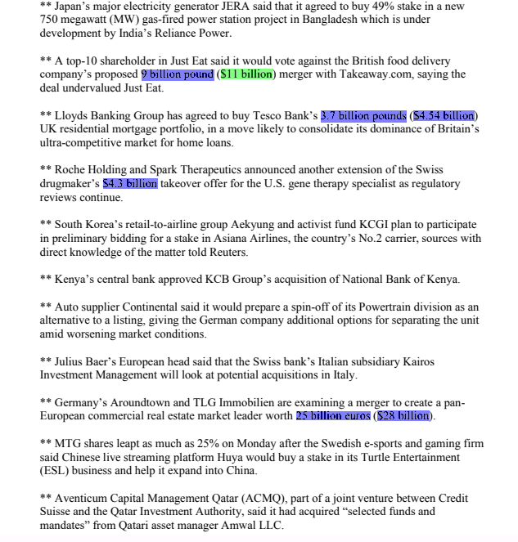
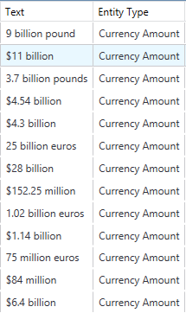
Natural Language Processing Engine – RPA 10.7
2
Named Entity Extraction
Entity extraction helps users extract entities from text such as: people, places, dates, amounts, companies, products, jobs, and titles.​ Use this feature to pull data from content not in a database that you want to store in a database and normalize to identify trends you can report on statistically.
Benefit: dramatically simplifies the process of finding any robots that may be tied to a specific process or system.
Example
Jim bought 300 shares of Acme Corp. in 2006. He sold them in 2009.
→ [Jim]_{Person} bought 300 shares of [Acme Corp.]_{Organization} in [2006]_{Time}. [Jim]_{Person} sold them in [2009]_{Time}
Named Entity Extraction pulls specific data and places it in a database
Notes:
Example uses could be to… download Amazon reviews for a specific product and extract entities such as people’s comments on their features – cable, sound, comfort, design from the website. The engine then stores this info in a database, then normalizes them to identify trends you can report on statistically.

Slide 27
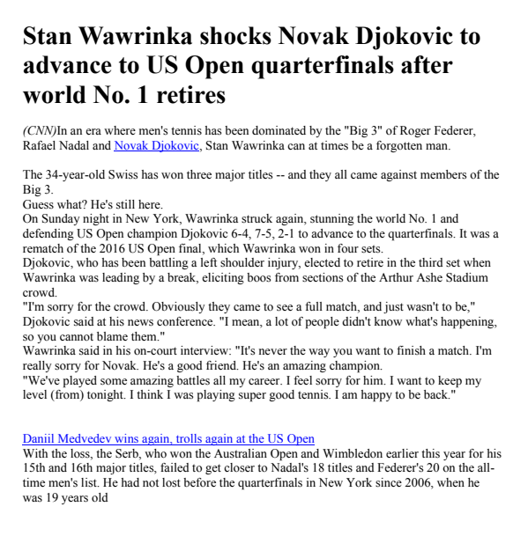
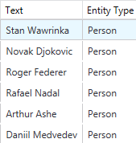
Named Entity Extraction
2
Automatically extract key entities in natural language, such as names, dates, places, amounts, etc.
Notes:
Before this feature, project designers had to teach the system with document examples and specify the data they were looking for. Now with NLP, just send the document to the engine and it returns all the key data you may need to complete the business process or store in a system of record.

Slide 28
Named Entity Extraction
Named-entity recognition (NER) (also known as entity identification, entity chunking and entity extraction) is a subtask of information extraction that seeks to locate and classify named entity mentions in unstructured text into pre-defined categories such as the person names, organizations, locations, medical codes, time expressions, quantities, monetary values, percentages, etc. … Named-entity recognition is often broken down … as two distinct problems: detection of names, and classification of the names by the type of entity they refer to (e.g. person, organization, location and other^{[7]}). (Wikipedia)
Named-entity recognition helps extract entities/objects/things from text that cannot be found with regular expressions or by searching the content of a known list or database table (Markus Lust)
Named Entity Extraction can help
a customer to find the names of all persons or companies on a document irrespective of whether he has them in a database
to understand the sentiment associated with an object, thus allows to detect what aspect of a product or service is being seen positively or negatively
to store all person names as meta data in a system of record for GDPR use cases where a person executes their right to be forgotten

Slide 29
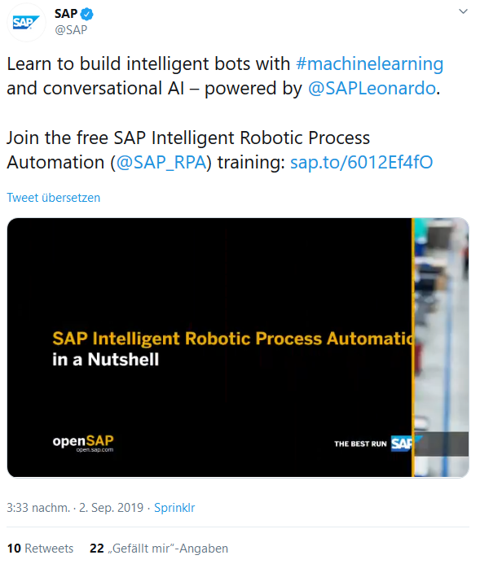
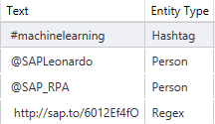
Named Entity Extraction
Examples

Slide 30
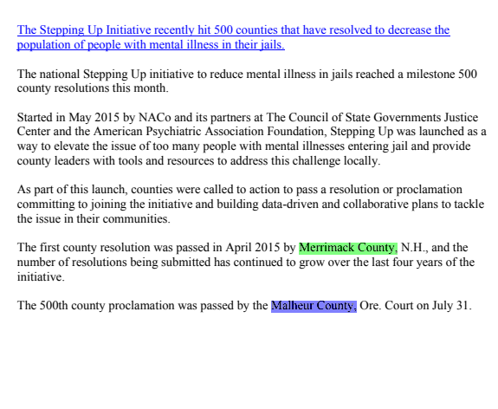

Named Entity Extraction
Examples (custom entity „County“)

Slide 31
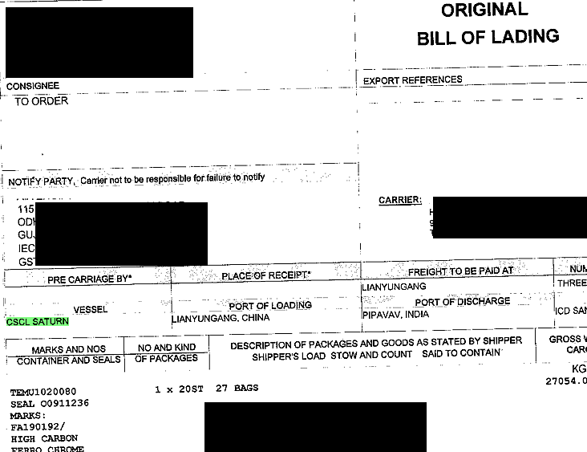
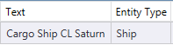
Named Entity Extraction
Examples (custom entity „Ship“ including normalization)

Slide 32
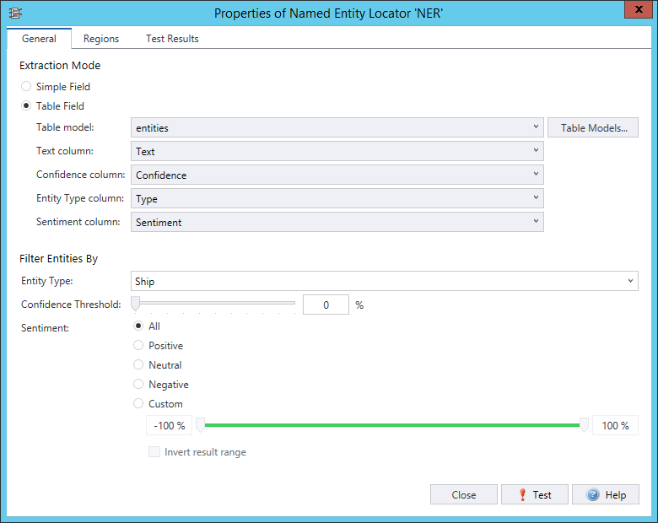
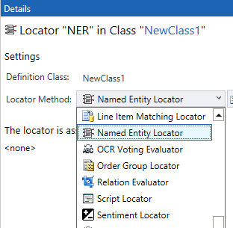
Named Entity Extraction
Can return
a simple field
or a table
Can be filtered by
Type
Confidence
Sentiment

Slide 33
Named Entity Extraction
Using sentiment on entity level (a proof of concept done in 2018 with a different NLP engine)
Downloaded Amazon reviews for a specific sony headset
Extracted entities of type „object“ (plug, cable, sound, comfort, design, etc.)
Stored the sentiment scores associated with these entities in a database
Normalized the entities ( „design“ = „optics“ etc.)
Could identify a clear trend: Design and comfort great, but cable bad (too short, breaks easily etc)
This works only on large amounts of data
It oly provides trends and indicators
Think of applying this to
Reviews of a customer product or service on Amazon, hotels.com, twitter, facebook etc
Detect trends and red flags

Slide 34
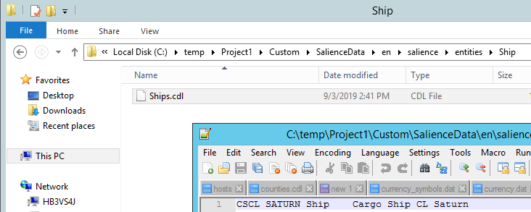
Named Entity Extraction
Customizing entities
First. Read documentation! As this is a service pack, detailed documentation is only in the release notes!
Create custom entity files in specific subfolders within the project
KTM takes care of deploying the custom entitiy files

Slide 35
Named Entity Extraction
Customizing entities
Format
Entity String<TAB>Entity SubType<TAB>Normalize Entity
Filename
Ship.cdl
→ „Ship“ = Entity Type
„.cdl“ ending required

Slide 36
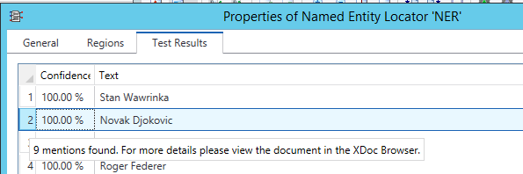
Named Entity Extraction
Mentions
Locator test dialog highlights only one mention (most relevant one)
Tooltip indicates there are more

Slide 37
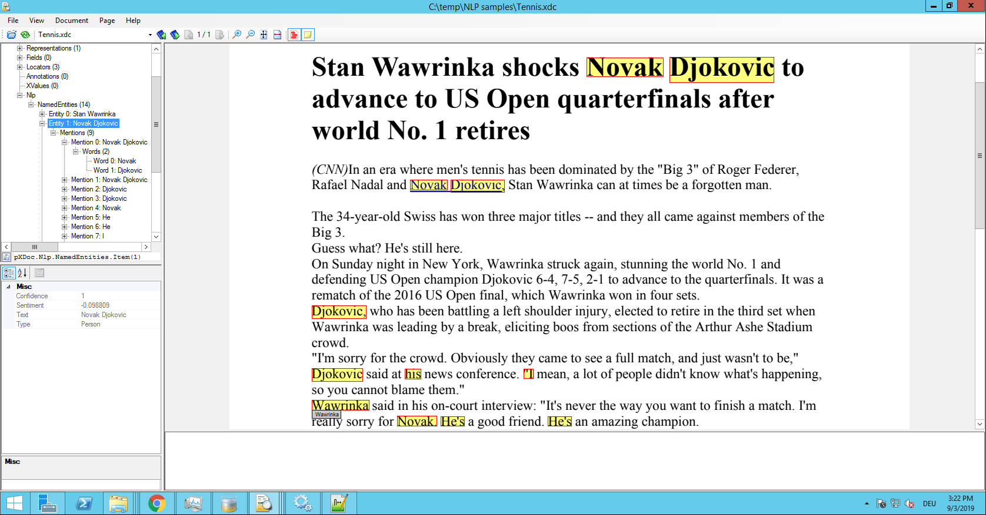
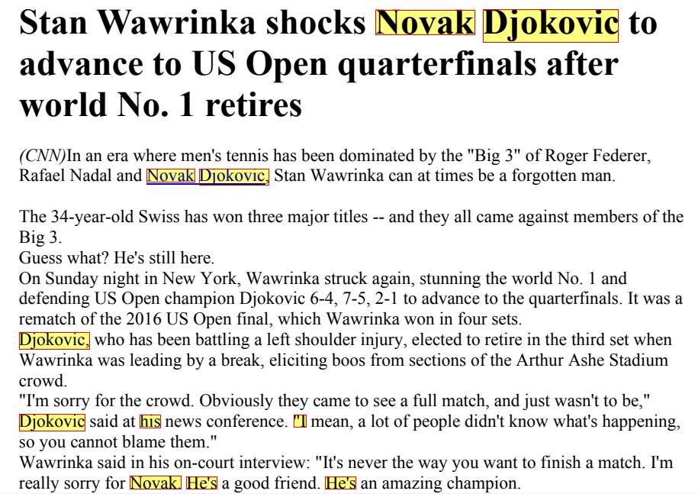
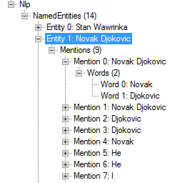
Named Entity Extraction
Mentions
Details in XDocBrowser

Slide 38
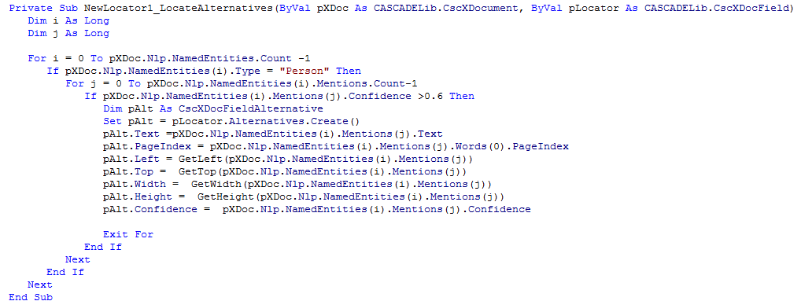
Named Entity Extraction
Scripting
Example 1: pXDoc.Nlp.NamedEntities(1).Mentions(1).Confidence
Example 2 (a script locator that returns a custom filtered entity set):

Slide 39
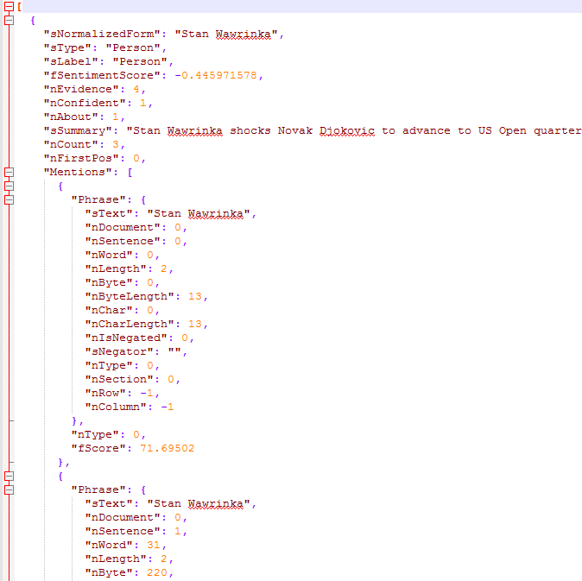
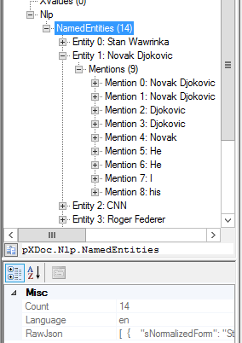
Named Entity Extraction
Raw NLP engine results
pXDoc.Nlp.NamedEntities.RawJson

Slide 40
Named Entity Extraction
Raw NLP engine results
Additional NLP information, like Summaries and Themes
E.g. All themes found in the previous „Tennis“ document:
"sTheme": "major titles",
"sTheme": "full match",
"sTheme": "court interview",
"sTheme": "left shoulder injury",
"sTheme": "third set",
"sTheme": "eliciting boos",
"sTheme": "good friend",
"sTheme": "amazing champion",
"sTheme": "time men",
"sTheme": "really sorry",
"sTheme": "amazing battles",

Slide 41

AI is often looking for the Needle in the Haystack
5 Needles and 10 Hay – Precision & Recall
In the perfect world:
We find 5 needles and 0 hay.
Precision=100%
Recall = 100%
If we find 4 needles and 3 straw:
Precision = 4 from 7 are needles = 57%
Recall = 4 from 5 needles found = 80%

Slide 42


True/False Positive/Negatives
Most AI companies are misleading when they give accuracy metrics, because they give you TP+FN, and they NEVER tell you what is happening with the false positives.
Do not believe or trust them, ask them for False Positive and False Negative rates.
Even Precision/Recall metrics obscure the truth.
FP
TP
FN
TN

Slide 43
4 problems that AI is used to solve
Recall
Find all the angry customers to make them happy.
Precision
Try to deal with angry customers quicker
Trend
Are our customers angrier than yesterday?
Transaction
What does customer X want? (False Positives are DEATH)

Slide 44
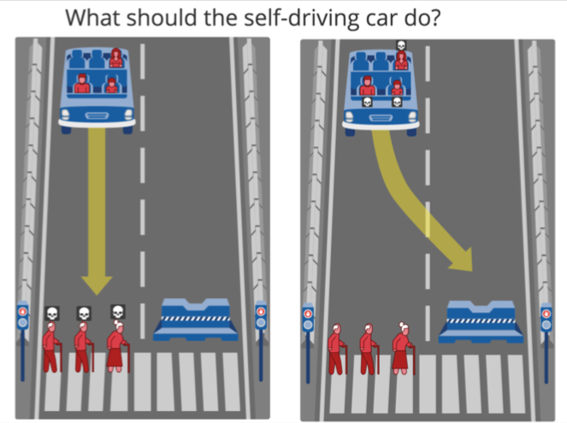
Self-driving car Ethics
2 million surveyed, on average, people wanted:
to spare human lives over animals
save more lives over fewer
prioritize young people over old ones
Americans don’t like jaywalkers!
Don’t harm cows in India. In 2017, the German Ethics Commission on Automated and Connected Driving recommended that self-driving vehicles should not make any distinction based on personal features, like age, gender and social status.
Notes:
https://www.pbs.org/newshour/science/in-a-crash-should-self-driving-cars-save-passengers-or-pedestrians-2-million-people-weigh-in

Slide 45



RPA today and the future of robotic automation
Intelligent RPA
Cognitive Decision Management
Thinking
Understanding customers
Complete transactions
Enhanced Digitization
Basic Digitization
Analyzing & processing data
Integrated into other business process platforms
Consider complexity & maintaining
Use cases require understanding
High risk
Aggregate data
Consolidate access to data
Update systems
Acting
Intelligent RPA connects to analytics, multi-channel capture, process automation, enterprise search, NLP
Notes:
[Speaker Notes] It’s important to explain where RPA is today, and the future direction. Cognitive learning is important to the future of robots, but its not where companies should start. The cost and complexity of implementing and maintaining a cognitive or machine learning platform is quite extensive. Where as intelligent robots with sophisticated business rules can be implemented in a matter of a few days.
RPA today and the future of robotic automation can really be broken into three phases where we expect to see robots advance from simply acting to be critical thinkers.
The first phase of RPA focuses on digitizing operational processes, where we call this basic digitization. Robots automate simple tasks like aggregating data, consolidating access to data from multiple systems, updating systems by replacing data entry tasks. This first phase really does not require a lot of knowledge about the data, and the business rules tend to me static and well understood.
Stage 2 takes RPA to what we’ll call enhanced digitization where a robot is now automating activities that involve analysis and processing of data where a deeper level of intelligence is required. The data could be structured and unstructured data, and the robots gather knowledge from the target data set or document, possibly communicating with external systems to gather further knowledge. For example, leveraging content analytics to classify the content before processing. The business logic and rules become more advanced, and in many cases robots play a key role in a broader process automation platform. For example, in a consumer lending process robots might handle specific tasks, and communicate the results to a larger end-to-end process.
The final stage is really the future of robots where cognitive decision management. In this stage RPA taps into external knowledge to make decisions, where robots break away from highly structured and business logic of stages 1 and 2. While cognitive has the stage to significantly alter the knowledge-worker labor force, all indications are we still have several years ahead of us before this type of technology becomes mainstream. There are many challenges with using neural network approaches like Google DeepMind and IBM Watson, those challenges being they require large data sets to be effective, and change management can impose roadblocks that hold back the advancing the cognitive learning platform.

Slide 46

The Future of the Digital Workforce
Head Work: Cognitive Automation
Hand Work: RPA
Notes:
[Talk track: RPA addresses the low-hanging fruit—a cost-effective way to transform cubicle work today. You also want to look towards the future as you plan and map out your digital strategy and prepare your organization to operate as an optimally-performing intelligent enterprise. For example, much of the Know Your Customer compliance process is very labor-intensive, mundane work being done by highly-skilled analysts. RPA automates that mundane, manual work. AI analyzes it.]

Slide 47
Document Understanding
Cognitive Document Automation
Intelligent Document Recognition
Human & robot together understand what they read

Slide 48





What is Document Understanding? (All information has context)
General Knowledge
Specific Knowledge
Learning
Understanding
=
Reading
+
+
+
Precisely knowing the intent of the author
OCR
Letters & words
This is not understanding
People’s names, City names, Tax rates, Mathematics, Month names, Job names…
Date of birth of each customer, order database signature always on the last page.
Remember and use new general & specific knowledge next time.
Notes:
Reading= OCR = intelligence of a 4 year old child.
General knowledge (about documents and the world)= city names, zips codes, mathematics, languages, spelling, month names, common occupations.
The words “date” and “Datum” often appear to the left of a date.
One Third of Americans share only 1000 family names – Smith, Johnson, Williams, Brown, Jones, Miller, Davis, Garcia, Rodriguez.
Robots are good at getting general knowledge about the world.
Specific knowledge (about this document) = the address and date of birth of every customer. Database of recent orders. This document always has the date in top left corner.
Learning by observing= gaining general and specific knowledge.

Slide 49
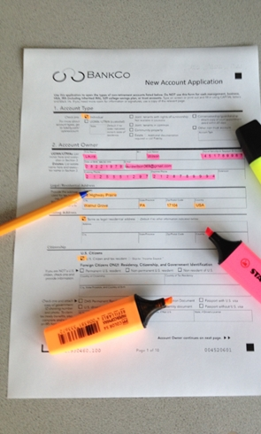
All you need is paper and highlighters
Classify
Separate/Review
Extract
Folder
Correct/Validate
Verify
Learning

Slide 50
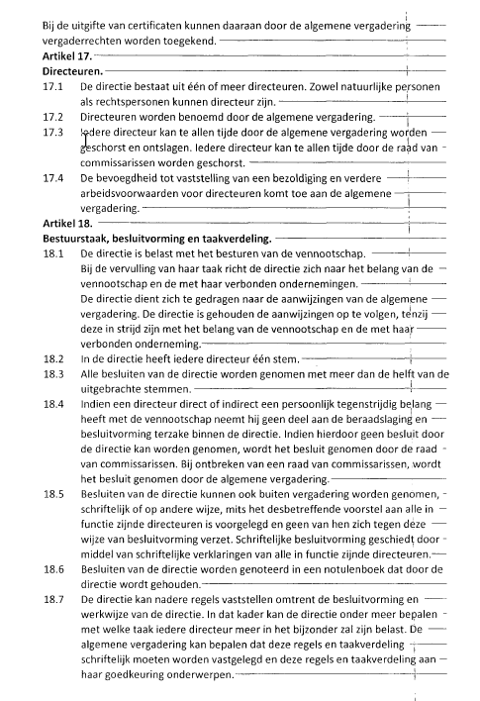
Document Understanding –what does the document mean?
Document
Data
Class | Corporate contract
CustomerID | 65483
Document Date | 23/11/2018
Signed | True
Stock owned | 25%
Expiry | 31/12/2027

Slide 51
Resources for RPA & AI
All of David’s resources. https://trello.com/invite/b/utV8huAE/329f55e0aea7d8a0ab8bec04e9bf38a1/success-with-kofax-rpa-ai
Including Links to General AI training
David’s Transformation Book (more than 3000 readers!) – the definitive guide to success in any Kofax Transformation project. How to teach a robot, not program it. https://github.com/KofaxRPA/Kofax-Transformation-Best-Practices/releases/tag/1.0
David’s videos https://www.dropbox.com/sh/vruefpxmfztpv6r/AAD8qxW6igN2BuAPNH3NzTdWa?dl=0
Robots and Transformation Techniques https://github.com/KofaxRPA

Slide 52


Excel and Kofax RPA
An Excel Document
Is accessible to only one person: this inhibits transparency
Hides secret business processes and logic
Is always out of date
Always creates work for owner AND for the recipient
Gen X and Gen Y love and need Excel. Millennials will move away from Excel.
Excel users are biggest problem for Kofax RPA. You will fight their behaviour all the time.

Slide 53



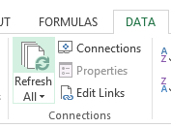

Technical Architecture
Download small amounts of data from “closed” systems via web, csv, desktop
Send and receive Excel documents
Change data in System of Record
like a human
Kofax RPA
SQL Database
Systems of Record
IT
Provides SQL views or tables from large business systems
Notes:
Rarely in practice does a single robot connect to two different systems of record. Robots synchronize from a system of record to a central SQL database where other robots move the data along.
Write simple robots that do simple tasks, rather than bigger robots trying to do two or more tasks.

Slide 54
Databases are necessary for performance and complex queries
Kofax TotalAgility
Kofax RPA
SQL Database
Systems of Record
Data & Metrics Team
SQL Views
Kofax Analytics
Notes:
Rarely does a single robot connect to two different systems of record.

Slide 55
KTA & Kofax RPA
Kofax RPA
Kofax Total Agility
Little human interaction
Simple tasks with clear start, middle and end
Cannot be interrupted or changed
Simple scheduling. Not recommended for robots to call robots.
Quicker to build, test, debug and deploy
Human Interaction in web portal
Complex Case Management over days, weeks
Can be interrupted and changed
Complex and efficient scheduling and dependencies
Start Robot B when Robot A finishes are returns value X

Slide 56
Integrating Kofax RPA with Kofax Total Agility
KTA can only call a robot synchronously
KTA will wait until the robot finishes.
The robot should be finished within a few minutes.
There is no ”Fire & Forget”
KTA will suspend a robot that fails. We build custom error handling.
KTA 7.4.1(?) supports auto-retry X times.
Kofax RPA can control KTA
Create jobs
Trigger events
Requires KTA SOAP SDK
Kofax internally does not use this

